Slide 1

Measuring Performance
CSC4010
David Cutting – d.cutting@qub.ac.uk

Slide 2
Measuring Parallel Performance
Just because something can be or is parallelised doesn’t mean it’s worth doing
There is a trade-off both in terms of the human overhead (development time) and the technical overhead (context switching etc)
So when we have a parallel system, it’s important to be able to measure how ”well” it is performing

Slide 3
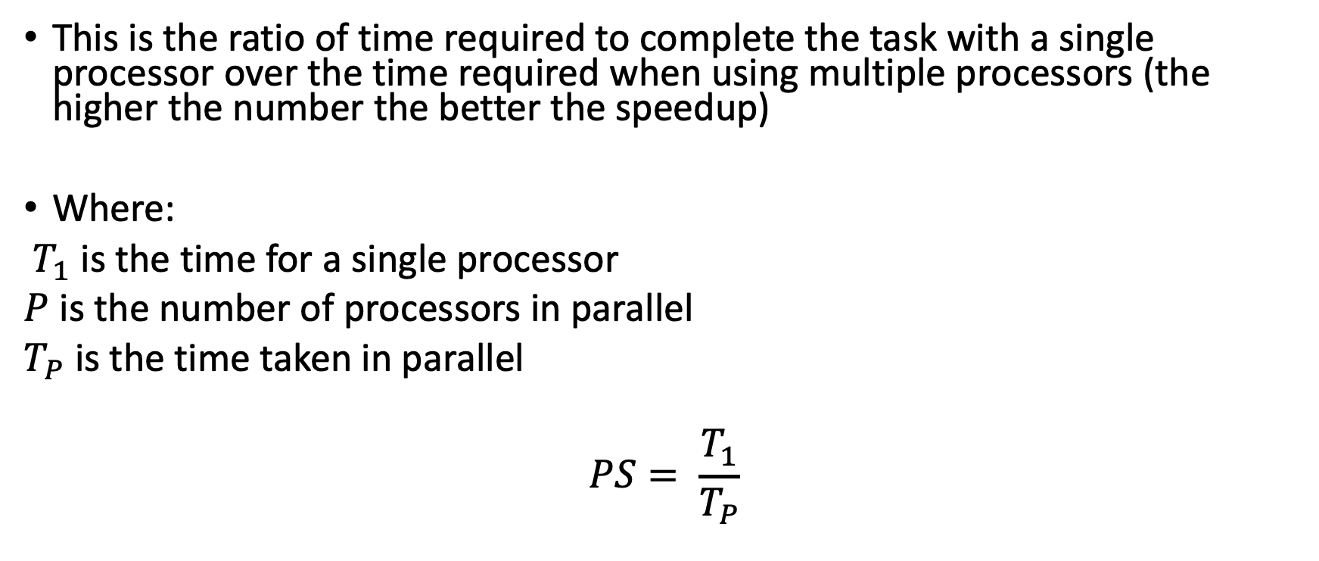
Parallel Speedup (PS)
This is the ratio of time required to complete the task with a single processor over the time required when using multiple processors (the higher the number the better the speedup)
Where:
$T_{1}$ is the time for a single processor
$P$ is the number of processors in parallel
$T_{P}$ is the time taken in parallel
$$PS= \frac{T_{1}}{T_{P}}$$

Slide 4
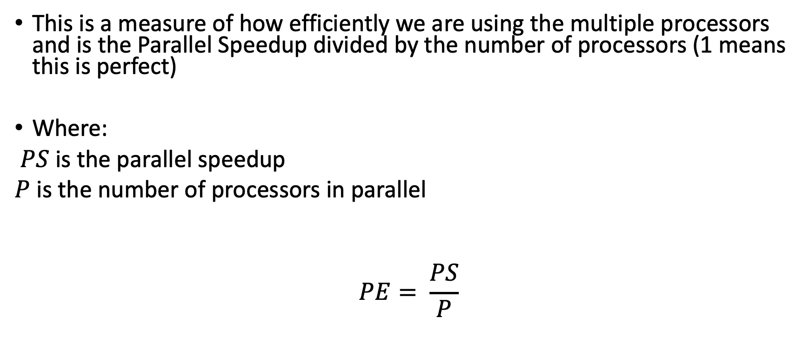
Parallel Efficiency (PE)
This is a measure of how efficiently we are using the multiple processors and is the Parallel Speedup divided by the number of processors (1 means this is perfect)
Where:
$PS$ is the parallel speedup
$P$ is the number of processors in parallel
$$PE= \frac{PS}{P}$$

Slide 5
Amdhal’s Law
Gives the theoretical maximum PS of code
Based on the fraction of code which can be parallelised
For example single thread execution takes 100 seconds, and the part of the code that can be parallelised takes 50 of those seconds (50% of time) then the maximum possible speedup is 2

Slide 6
Example Data: Prime Number Finder
Cores | Sequential Total | Sequential CPU | OpenMP Total | OpenMP CPU | OpenMP PS | OpenMP PE
1 | 37.52 | 37.52 | 38.59 | 38.58 | 0.972 | 0.972
2 | 40.05 | 40.04 | 20.17 | 40.19 | 1.986 | 0.993
4 | 39.27 | 39.27 | 10.66 | 39.63 | 3.684 | 0.921
6 | 38.1 | 38.1 | 7.07 | 38.79 | 5.389 | 0.898
8 | 37.5 | 37.5 | 7.17 | 37.11 | 5.230 | 0.654
8 | 39.2 | 39.2 | 6.09 | 38.94 | 6.437 | 0.805
8 | 35.45 | 35.45 | 5.11 | 37.09 | 6.937 | 0.867
10 | 41.21 | 41.2 | 4.54 | 41.07 | 9.077 | 0.908
12 | 40.24 | 40.23 | 4.58 | 40.97 | 8.786 | 0.732
16 | 41.14 | 41.14 | 3.34 | 41.13 | 12.317 | 0.770
24 | 36.59 | 36.58 | 2.54 | 37.68 | 14.406 | 0.600
32 | 36.21 | 36.21 | 1.86 | 37.17 | 19.468 | 0.608
64 | 33.36 | 33.36 | 1.22 | 35.63 | 27.344 | 0.427
128 | 31.25 | 31.24 | 0.68 | 33.34 | 45.956 | 0.359

Slide 7
Example Data: Prime Number Finder
Cores | Sequential Total | Sequential CPU | OpenMP Total | OpenMP CPU | OpenMP PS | OpenMP PE
1 | 37.52 | 37.52 | 38.59 | 38.58 | 0.972 | 0.972
2 | 40.05 | 40.04 | 20.17 | 40.19 | 1.986 | 0.993
4 | 39.27 | 39.27 | 10.66 | 39.63 | 3.684 | 0.921
6 | 38.1 | 38.1 | 7.07 | 38.79 | 5.389 | 0.898
8 | 37.5 | 37.5 | 7.17 | 37.11 | 5.230 | 0.654
8 | 39.2 | 39.2 | 6.09 | 38.94 | 6.437 | 0.805
8 | 35.45 | 35.45 | 5.11 | 37.09 | 6.937 | 0.867
10 | 41.21 | 41.2 | 4.54 | 41.07 | 9.077 | 0.908
12 | 40.24 | 40.23 | 4.58 | 40.97 | 8.786 | 0.732
16 | 41.14 | 41.14 | 3.34 | 41.13 | 12.317 | 0.770
24 | 36.59 | 36.58 | 2.54 | 37.68 | 14.406 | 0.600
32 | 36.21 | 36.21 | 1.86 | 37.17 | 19.468 | 0.608
64 | 33.36 | 33.36 | 1.22 | 35.63 | 27.344 | 0.427
128 | 31.25 | 31.24 | 0.68 | 33.34 | 45.956 | 0.359

Slide 8
Example Data: Prime Number Finder
Cores | Sequential Total | Sequential CPU | OpenMP Total | OpenMP CPU | OpenMP PS | OpenMP PE
1 | 37.52 | 37.52 | 38.59 | 38.58 | 0.972 | 0.972
2 | 40.05 | 40.04 | 20.17 | 40.19 | 1.986 | 0.993
4 | 39.27 | 39.27 | 10.66 | 39.63 | 3.684 | 0.921
6 | 38.1 | 38.1 | 7.07 | 38.79 | 5.389 | 0.898
8 | 37.5 | 37.5 | 7.17 | 37.11 | 5.230 | 0.654
8 | 39.2 | 39.2 | 6.09 | 38.94 | 6.437 | 0.805
8 | 35.45 | 35.45 | 5.11 | 37.09 | 6.937 | 0.867
10 | 41.21 | 41.2 | 4.54 | 41.07 | 9.077 | 0.908
12 | 40.24 | 40.23 | 4.58 | 40.97 | 8.786 | 0.732
16 | 41.14 | 41.14 | 3.34 | 41.13 | 12.317 | 0.770
24 | 36.59 | 36.58 | 2.54 | 37.68 | 14.406 | 0.600
32 | 36.21 | 36.21 | 1.86 | 37.17 | 19.468 | 0.608
64 | 33.36 | 33.36 | 1.22 | 35.63 | 27.344 | 0.427
128 | 31.25 | 31.24 | 0.68 | 33.34 | 45.956 | 0.359

Slide 12

?
?
?
?
?
?
?
?
?
?
?

